Slide 1
Troubleshooting Production Issues
How to make your boss think you’re Superman
Notes:
THINGS TO SETUP FIRST:
Open an admin command prompt
Have the memory dump sample code ready in visual studio
Today I’m hoping to show the various options available to you when troubleshooting production issues. When these crop up you’ll really begin to appreciate having test coverage like we’ve previously talked about, because it will reduce the frequency of these incidents. Can I get a show of hands who has had to deal with a production emergency before?

Slide 2
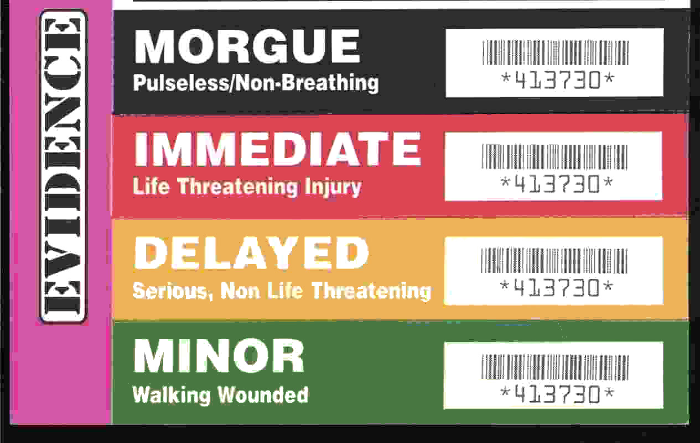
Triage - the sorting of patients (as in an emergency room) according to the urgency of their need for care
http://www.merriam-webster.com/dictionary/triage
Notes:
This term was popularized in World War I by French doctors treating the wounded at aid stations. They would sort the wounded into three categories:
Those who are likely to live, regardless of what care they receive;
Those who are likely to die, regardless of what care they receive;
Those for whom immediate care might make a positive difference in outcome.

Slide 3
Triage Steps
What environment?
How many people are affected?
What are the symptoms?
Does it happen all the time or intermittently?
Try to narrow down where the issue is occurring
Client-side?
Server-side?
Backend services?
Database?
Third-party?
Notes:
When a production issue is reported we need to first triage, or diagnose, that issue to decide how we should deal with it.
What environment? This seems obvious but we’ve had situations where a miscommunication delayed our response to the issue. Even just this week, someone asked me if the RavenDB server was having and issue because the website was timing out and wouldn’t load. I knew the server was fine because I had just checked it, so I asked what they were seeing happen. At that point they mentioned the QA site wouldn’t load.
How many people are affected? Not to downplay the importance of issues that might only be affecting a few people, but this will affect our response to the issue. Should we drop everything to focus on the issue or is this something we should refer to QA to investigate further? COMMUNICATION IS KEY. A couple months ago an issue occurred that was affecting everyone, but I inferred from the person I was talking to that the issue was of minor importance and only affecting some people. Because of that, the issue lasted for over an hour before the underlying problem was resolved. The failure went both ways, they never mentioned that it was happening across the board, and I never asked.
What are the symptoms? This may described like “When I click x then y happens.” We need a description of the problem with as much detail as possible so that we aren’t led down the wrong path. Once we get the initial description we can ask more questions to help us narrow down where the issue is occurring. From there we can begin looking at that particular process. We have a lot of interconnected systems, so narrowing down whether the issue is with the phone controls, call routing, general application, or something else will help us resolve the issue as quickly as possible.
This will also determine our next steps. Do we begin looking at the servers? Do we talk to the database team? Do we need to contact a third-party and report the issue?
These last two points will start to inform us on how we should approach resolving the issue, so we can then dig deeper, which brings us to… debugging.

Slide 4
Debugging
Gather details
IDs
Time of occurrence
Expected behavior
Actual behavior
Reproducible?
Is it safe to reproduce the issue?
Check the logs
Check all the logs
Increase logging level or try other tracing (e.g. IIS)
Other tools like Process Explorer or Process Monitor
Memory dump?
Notes:
QA will often do a lot of this for us, and by the time it’s come to us we’ll already know whether it’s an environment issue or it’s a bug in the system. If we can reproduce the issue locally or in QA, it’s generally easier to debug it there.
If we can only reproduce the issue in production, we need to determine whether we can safely do so. We don’t want to cause more problems or corrupt data. What are some things we wouldn’t want to intentionally reproduce? (e.g. duplicate emails to customers, transmitting data to carriers, irreversible actions like discarding a customer’s application (can be reversed manually in DB but is time consuming)
The logs are going to be most important when debugging something that is hard to reproduce. Sometimes we may forgot all the different places that have logs, make sure to check them all. Don’t forget fubu diagnostics/instrumentation might have details.
Sometimes increasing the logging level or trying custom logging can help. IIS has a request tracing feature that can be enabled that stores a lot of details about a particular web request.
There are other tools that can help us look deeper at an application. Process Explorer has a lot of nice functionality that I will demo later.
If all else fails we might need to take a memory dump, but this should only be done as a last resort. This is time consuming and tedious to look through. Before I get into that, let’s talk about… Logging.

Slide 5
Logging
Don’t log too much
Don’t log too little
Info = normal log level for production
Debug/Verbose = local/dev/sometimes QA
Log exceptions
AppDomain.CurrentDomain.UnhandledException
TaskScheduler.UnobservedTaskException
SetObserved()
Event Log
Contextual information is vital
IDs
“Call has ended” vs “Call 12345 has ended with status Transferred”
Don’t forget to add this to exceptions
Notes:
Logging is something we take for granted most of the time, until we need it and realize we didn’t log the right things. We have to be careful not to log too much, but we also have to be careful not to log too little. Think of Goldilocks and the Three Bears. When we log we want to get it just right, and it takes some practice to learn what kinds of things are useful to log.
When we configure logging in production, we’ll typically set it to log at INFO. Anything that you’re going to need to see in order to tell that the application is functioning normally should be logged at INFO. This includes things like logging when a user performs an action, a summary of what that action entailed, and interaction between other systems.
DEBUG level is what we’ll usually set when running locally, in dev, or in QA. DEBUG level may include fine-grained details about what the system is doing, database calls, and other frequent things that we usually don’t need to see. For example, we have a tool where a user can upload a file to be imported by the system. We’ll log at INFO when the user starts the import with the username and file name. When the import completes we’ll log at INFO again with a summary of what was imported. All of the individual pieces of data that were imported will be logged at DEBUG. We’ll use DEBUG in production when we need to dig deep to determine whether something happened or why it happened.
That covers logging at INFO and DEBUG, which brings us to ERRORS. Anytime something happens in the system that shouldn’t have happened, we should log an error. I’ll repeat that. Anytime something happens in the system that SHOULDN’T have happened, we should log an error. Most of time this will be in the form of logging an exception. We should log exceptions whether we catch and handle them or whether we allow them to go unhandled. Unavoidable exceptions from third-party libraries that become part of the control flow don’t necessarily need to be logged, but this should be considered on a case by case basis.
When exceptions go unhandled there are two ways we can get at them in order to log them. When an unhandled exception is thrown on a background thread, the process will crash. Before it does the AppDomain raises an event that we can listen to in order to see the exception before the process dies. When using TPL, the TaskScheduler has different rules for how it treats exceptions thrown from a Task. In .net 4.0 this would crash the process. The default behavior has changed in .net 4.5 to not crash the process. The TaskScheduler exposes and event that will be raised if the exception is never observed. The event args include a SetObserved() method that you can call to prevent it from crashing the process on .net 4.0. [Show code example of wiring up to the unhandled exception events]
If we missed seeing the exception that caused the crash, we can check the Application Event Log and might be able to see the exception there. [Show example of a crashing app and the exception that is created in the event log].
As Jeremy and Corey stressed yesterday, logging the right details is extremely important and can really make our lives easier. Including IDs really makes a difference. Simply logging “call has ended” might be enough in dev when there’s only one phone call, but is useless in a production log. When you’re writing a log statement ask yourself “How will I correlate this with everything else that’s being logged?”
Raise your hand if you’ve used StructureMap. Keep your hand up if you’ve ever had a configuration exception thrown. When you’re resolving an instance the StructureMap exception that is thrown only states that it was missing the dependency, but it doesn’t tell you where in the object graph that dependency was requested, which makes it hard to figure out why it was misconfigured. (Jeremy has promised this is better in StructureMap 3).

Slide 6
Diagnose the issue
“The tool isn’t working”
Type : System.Data.SqlClient.SqlException
Message : A network-related or instance-specific error occurred while establishing a connection to SQL Server. The server was not found or was not accessible. Verify that the instance name is correct and that SQL Server is configured to allow remote connections.
Notes:
Now that I’ve covered the steps for debugging an issue, let’s do a simple exercise. I’m going to play the role of a user and I’ve just reported to you “The tool isn’t working.” What do you do next?
-This is in production.
-This is happening to everyone.
-When I try to open a record the screen freezes with a spinner.
-Now we’re getting reports that the website won’t load either.
-Here’s what the log shows [show exception].

Slide 7
Tools
Visual Studio
"Debug Managed Memory" available in VS2013 Ultimate
WinDbg
DebugDiag
Memory/Performance Profilers
Process Explorer
Process Monitor
Notes:
Tools for debugging and analyzing memory dumps.
Visual Studio can open a memory dump, but the “Debug Managed Memory” feature is only available in Ultimate. You can still view threads/stack traces.
WinDbg is the one I use most often when digging into memory dumps
DebugDiag just released 2.0 and is becoming very useful.
If dealing with a memory leak, remember that it’s much easier to find using a memory profiler if it’s something you can reproduce locally. There are some profilers that can even be attached to a production application but you have to be very careful about when you decide to do so.
When I first looked at Process Explorer a long time ago it couldn’t display threads and stack traces for managed applications, which wasn’t very useful. Since then that functionality has been added and it’s now a useful tool for seeing what happening within a process while it’s still running. This can possibly help to see what’s happening when the process freezes without the need for a memory dump.
Process Monitor is another useful tool for viewing what a process is doing. It will show you everything the process is touching on the system (the file and registry handles it’s using).

Slide 8
Demo
Notes:
Demo managed stack traces in ProcessExplorer

Slide 9
Memory Dumps
Memory Leaks
Use a profiler when possible
Random crashes
Check the logs first
If you missed it in your log file, the Application Event Log might have it
Deadlocks
Infinite loops
Notes:
ONLY TAKE A DUMP AS A LAST RESORT – IT IS A SLOW AND PAINFUL PROCESS!
Try to reproduce memory leaks locally so you can use a profiler
Process crash may have logged the exception by using the tricks mentioned previously, don’t forget to check the Event Log
There are multiple ways to gather a dump which I’ll be demoing later, but first we need to configure our environment. Let’s talk about what WinDbg does for us. [next slide]

Slide 10
WinDbg
CTRL + D or File > Open Crash Dump
.loadby sos clr
!analyze -v
!Threads
!EEStack
!DumpHeap –stat
!GCRoot
!help
Notes:
Discuss the common commands used in WinDbg:
Ctrl + D to open a dump
“.loadby sos clr” must be called first for managed applications
!analyze –v is useful when opening a crash dump. It will check the last exception that was thrown and show you details about the thread that threw it. I’ll be demoing this later.
!Threads will display all of the managed threads in the application
!EEStack will print the full stack trace of every thread
!DumpHeap –stat will give you a summary of all the objects on the stack. When looking into high memory usage you’ll use this to find what’s using the most memory.
!GCRoot can be using to find what is holding onto a particular object
Walkthrough installing the tool. After the tool has been installed, we need to configure our symbol path so we don’t get this error [next slide].

Slide 11
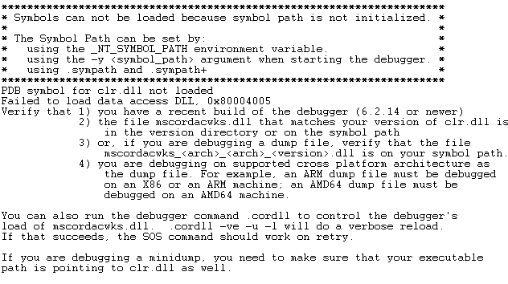
Configuration
Notes:
If you haven’t set up your symbol path, WinDbg will give this error and you won’t be able to debug through a dump.

Slide 12
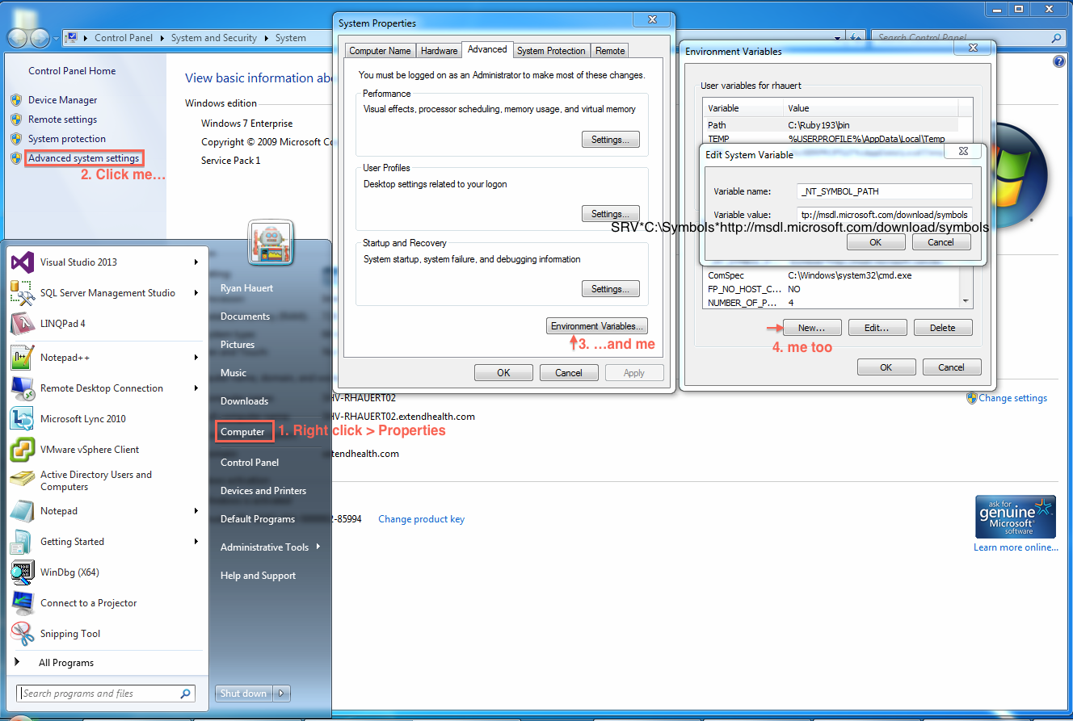

Slide 13
Demo
Notes:
First demo the crash, show what the event log looks like, then show how to take a crash dump using ADPlus
Open the dump in WinDbg and show !analyze –v
Can also show !Threads and !EEStack here
Next demo the memory leak
Show how to take the dump using Task Manager
Open the dump in WinDbg to show !DumpHeap –stat
Open the dump with DebugDiag to show memory diagnostics
If there’s time left demo a hang
Show stack traces in Process Explorer
Take the dump with ADPlus –hang
Show !EEStack in WinDbg
Show the dump in Visual Studio
If there’s time left show Process Monitor

Slide 14
Further Reading
Exception handling in TPL
http://msdn.microsoft.com/en-us/library/dd997415%28v=vs.110%29.aspx
Debugging memory leaks in visual studio
http://blogs.msdn.com/b/visualstudioalm/archive/2013/06/20/using-visual-studio-2013-to-diagnose-net-memory-issues-in-production.aspx

